Slide 1

Final Presentation
Team Member: Enyu Wang, Vicky Wu, Yizhou Tu
Reflexis

Slide 2
What can managers do to improve sales?

Slide 3
Stores Breakdown
Stores
B2B Focused
B2C Focused
Large
Small
Large
Small

Slide 4
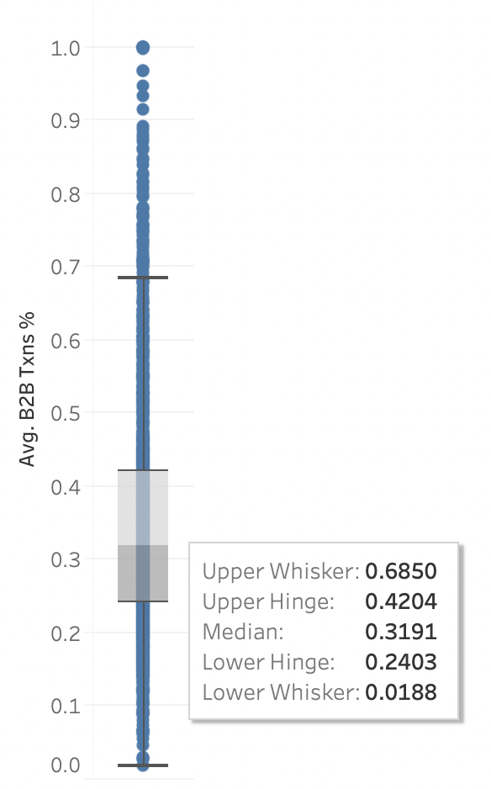
B2B & B2C focused stores
B2B Focused
517 stores
Box plot: Store’s average B2B Transaction % distribution
Used median of 0.3191 as cutoff for b2b and b2c focused stores
B2C Focused
516 stores

Slide 5
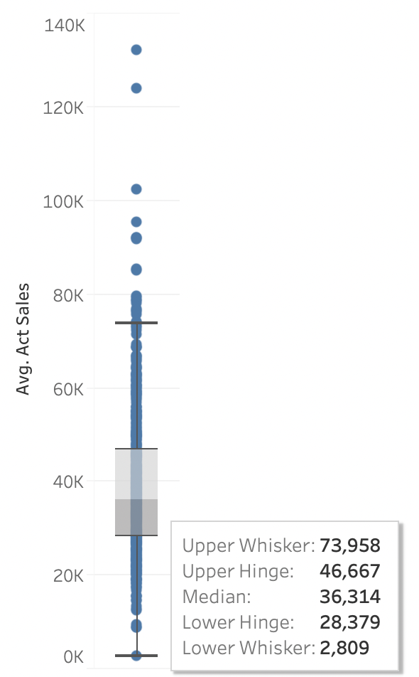
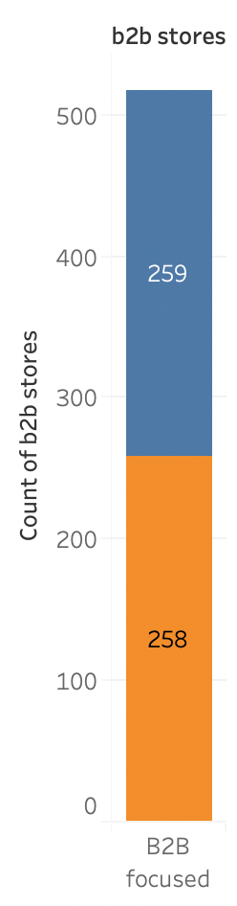
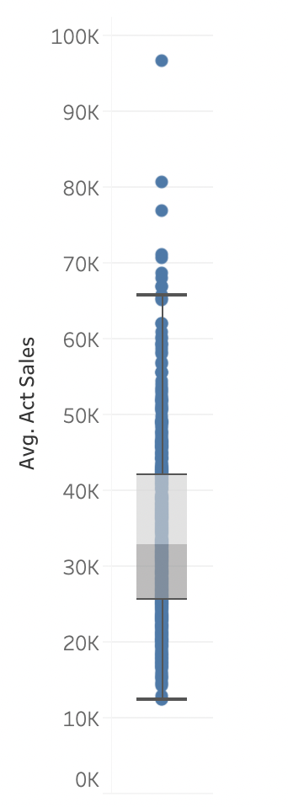
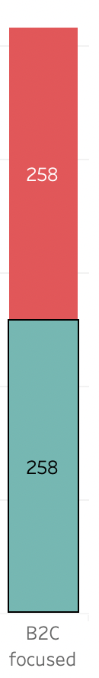
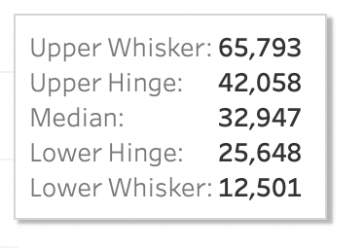
B2B Store Size
B2C Store Size
Small Store
Avg. Actual Sales < $36,314/week
Small Store
Avg. Actual Sales < $32, 947/week
Large Store
Avg. Actual Sales >= $36,314/week
Large Store
Avg. Actual Sales >= $32,947/week

Slide 6
Methodologies We are taking
Linear Regression:
- To explore if managers can improve the KPI of sales per labor cost by changing one or more of the variables
- Measure significance of each variable to sales per labor cost
Regression Tree:
- Breakdown major influencers to see how are they influencing sales per labor cost
- Use nodes to find suggestions for managers

Slide 7
Groups Overview - variables
Regressions tree & Linear Regression
Manager controlled variables:
- Wage
- Scheduled Edits
- Scheduled Shifts
- Logons
- Efficiency Difference(MGR-SYS)
- Execution On-time rate
Why not normalized?
- By building trees for each cluster these values can now be used to compare
- It is easier for managers to control purely numbers or behaviors rather than ratio

Slide 8
Linear Regression
For
B2B and B2C, Large and Small
stores

Slide 9
Groups Overview - Important variables
Linear regressions
B2B Focused Stores |  | B2C Focused Stores
Large | Small | Large | Small
Logons Wage Manager Scheduled Shifts Scheduled Edits Efficiency Difference | Logons Wage Manager Scheduled Shifts Scheduled Edits | Logons Wage Manager Scheduled Shifts Efficiency Difference On-time Rate | Wage Manager Scheduled Shifts Scheduled Edits On-time Rate

Slide 10
B2B Focused Stores
Large
Small
Logons | -0.03 | -0.02
Wage | 2.82 | 1.91
Scheduled Edits | -0.09 | -0.05
Manager Scheduled Shifts | -0.14 | -0.22
Efficiency Difference(MGR - SYS) | 27.37 | N/A
MAPE | 0.1580 | 0.2048
MAPE bench | 0.1625 | 0.2054
RMSE | 20.0864 | 24.3371
RMSE bench | 30.6872 | 24.8670
The coefficient is significantly large because the efficiency difference is a small number that’s measure in %

Slide 11
B2C Focused Stores
Large
Small
Logons | -0.03 | N/A
Wage | 3.75 | 2.46
Scheduled Edits | N/A | -0.09
Manager Scheduled Shifts | -0.16 | -0.21
Efficiency Difference(MGR - SYS) | 27.93 | N/A
On-time Rate | 9.60 | -2.18
MAPE | 0.1486 | 0.2407
MAPE bench | 0.1634 | 0.2470
RMSE | 21.4970 | 18.3139
RMSE bench | 23.3607 | 18.8703
Executions for large B2C are more sales-related
Executions for small B2C are less sales-related(e.g. Run errands, maintenance,etc.)

Slide 12
Large Stores
Small Stores
B2B
B2C
B2B
B2C
Logons | -0.03 | -0.03
Wage | 2.82 | 3.75
Scheduled Edits | -0.09 | N/A
Manager Scheduled Shifts | -0.14 | -0.16
Efficiency Difference(MGR - SYS) | 27.37 | 27.93
On-time Rate | N/A | 9.60
MAPE | 0.1580 | 0.1486
MAPE bench | 0.1625 | 0.1634
RMSE | 20.0864 | 21.4970
RMSE bench | 30.6872 | 23.3607
-0.02 | N/A
1.91 | 2.46
-0.05 | -0.09
-0.22 | -0.21
N/A | N/A
N/A | -2.18
0.2048 | 0.2407
0.2054 | 0.2470
24.3371 | 18.3139
24.8670 | 18.8703
>

Slide 13
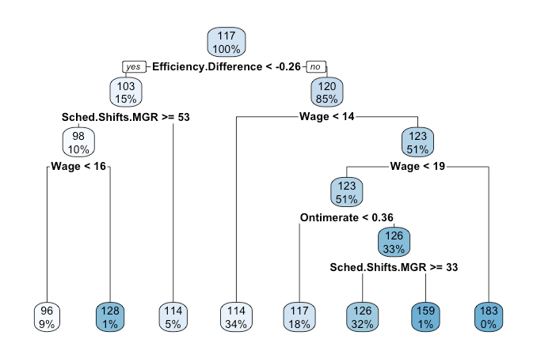
B2C large stores regression tree
Goal:
Providing practical suggestions for manager which they can control and drive up sales per horus
Important nodes:
Wage
Efficiency Difference
Manager Schedule shifts

Slide 14
Regression Tree Break Down
The First Split
Left branch: Efficiency difference < -0.26
Right branch Efficiency difference >= -0.26 (better manager efficiency)
Sales per Labor hrs (Mean): 117
100% of store weeks
Efficiency difference <-0.26
Yes
No
Mean: 103
15% of store weeks
Mean: 120
85% of store weeks

Slide 15
Mean: 103
15% of store weeks
Observation
When Manager schedule Shifts is greater or equal to 53, more shifts will bring down the sales per labor hrs.
Manager Schedule.Shifts >= 53
98
10%
114
5%

Slide 16
Mean: 103
15% of store weeks
Observation
Less wage can actually lead lower sales per hours
Manager Schedule.Shifts >= 53
98
10%
Wage <16
96
9%
128
1%
114
5%

Slide 17
Regression Tree Break Down
The First Split
Left branch: Efficiency difference < -0.26
Right branch Efficiency difference >= -0.26 (better manager efficiency)
Sales per Labor hrs (Mean): 117
100% of store weeks
Efficiency difference <-0.26
Yes
No
Mean: 103
15% of store weeks
Mean: 120
85% of store weeks

Slide 18
Mean: 120
85% of store weeks
Observation
34% of the store pay wage less than 14
Higher the wage, higher the sales per labor hrs
Wage <14
123
51%
114
34%

Slide 19
Mean: 120
85% of store weeks
Observation
0% means the number are rounding
Those stores performance are very unlikely (paying more or equal than 19 dollars wage)
Higher execution on-time rate and Lower the schedule shifts ⇒ larger the sales per labor horus.
Wage <14
123
51%
Wage <19
123
51%
Execution on-time rate <0.36
126
33%
Manager Schedule.Shifts >= 33
183
0%
114
34%
117
18%
126
32%
159
1%

Slide 20
Mean: 103
15% of store weeks
Mean: 120
85% of store weeks
Manager Schedule.Shifts >= 53
Wage <14
123
51%
98
10%
Wage <19
123
51%
Wage <16
Execution on-time rate <0.36
126
33%
Manager Schedule.Shifts >= 33
183
0%
96
9%
128
1%
114
5%
114
34%
117
18%
126
32%
159
1%

Slide 21
B2C Large Stores
Model Quality
Error measurement:
- RMSE: 22.16
- RMSE Benchmark: 23.65
- RMSE Improvement: 6.30%
- MAPE: 14.88%
- MAPE Benchmark: 16.72%
- MAPE Improvement: 11.01%

Slide 22
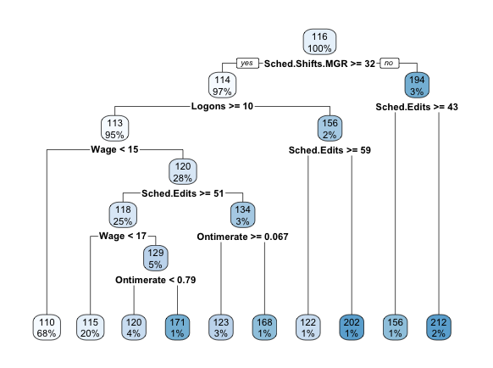
B2B large stores
Important nodes:
- Sched.Edits
- Wage

Slide 23
B2B large stores
Mean: 116
100% of store weeks
Observation:
- Store weeks with Scheduled shifts less than 32 has 194 as sales per labor hour, but these stores might be naturally
-
Manager Scheduled Shifts >= 32
Yes
No
Mean: 114
97% of store weeks
Mean: 194
3% of store weeks

Slide 24
B2B large stores
Given sched.shifts > = 32
Given sched.shifts < 32
114
97%
194
95%
Observation:
- Logons: when scheduled shifts greater than 32, more logons does not drive sales per labor hour;
- More schedule edits bring down sales per labor hour;
Logons >= 10
Sche.Edits >= 10
113
95%
156
2%
156
1%
212
95%
Sche.Edits >= 59
122
1%
202
1%

Slide 25
B2B large stores
Given
Sched.shift is >= 32 & logons >= 10
113
95%
Observation:
- Higher wage usually return in higher sales per labor hour
- managers will want to take time to think over the balance of lower wage and longer time spent to make a sale.
Wage < 15
110
68%
120
28%
Wage < 13
105
22%
112
45%

Slide 26
B2B large stores
Given
Sched.shift is >= 32 & logons >= 10
& wage > 15
120
28%
Observations:
- Again we observe that fewer edits nodes has better performance at sales per labor hour
- Again fewer wage does not return higher higher sales per labor hour
Sche.Edits >= 51
118
25%
134
3%
Wage < 13
115
20%
129
5%

Slide 27
B2B large stores
Given
Sched.shift is >= 32 & logons >= 10
& wage > 17
& Sched.edits >= 51
Given
Sched.shift is >= 32 & logons >= 10
& wage > 15
& Sched.edits < 51
129
5%
134
3%
Ontime rate < 0.79
Ontime rate >= 0.67
120
4%
171
1%
123
3%
168
1%
Observations:
- Unlike more influential variables, on-time rate does influence to the same direction

Slide 28
B2B large stores
Model Quality
Error measurement:
- RMSE: 27.99
- RMSE Benchmark: 31.12
- RMSE Improvement: 10.06%
- MAPE: 15.47%
- MAPE Benchmark: 16.72%
- MAPE Improvement: 7.48%

Slide 29
Regression Tree Model Measurement
- Marginal improvement from benchmark
- Large stores tend to have better improvement
 | B2B Large | B2C Large | B2B Small | B2C Small
MAPE | 15.47% | 14.88% | 19.55% | 23.47%
MAPE BENCH | 16.72% | 16.28% | 19.87% | 24.58%
MAPE IMPR | 7.48% | 6.30% | 1.61% | 4.51%
RMSE | 27.99 | 22.16 | 24.45 | 18.56
RMSE BENCH | 31.12 | 23.65 | 25.45 | 18.92
RMSE IMPR | 10.06% | 11.01% | 3.92% | 1.9%

